Slide 1
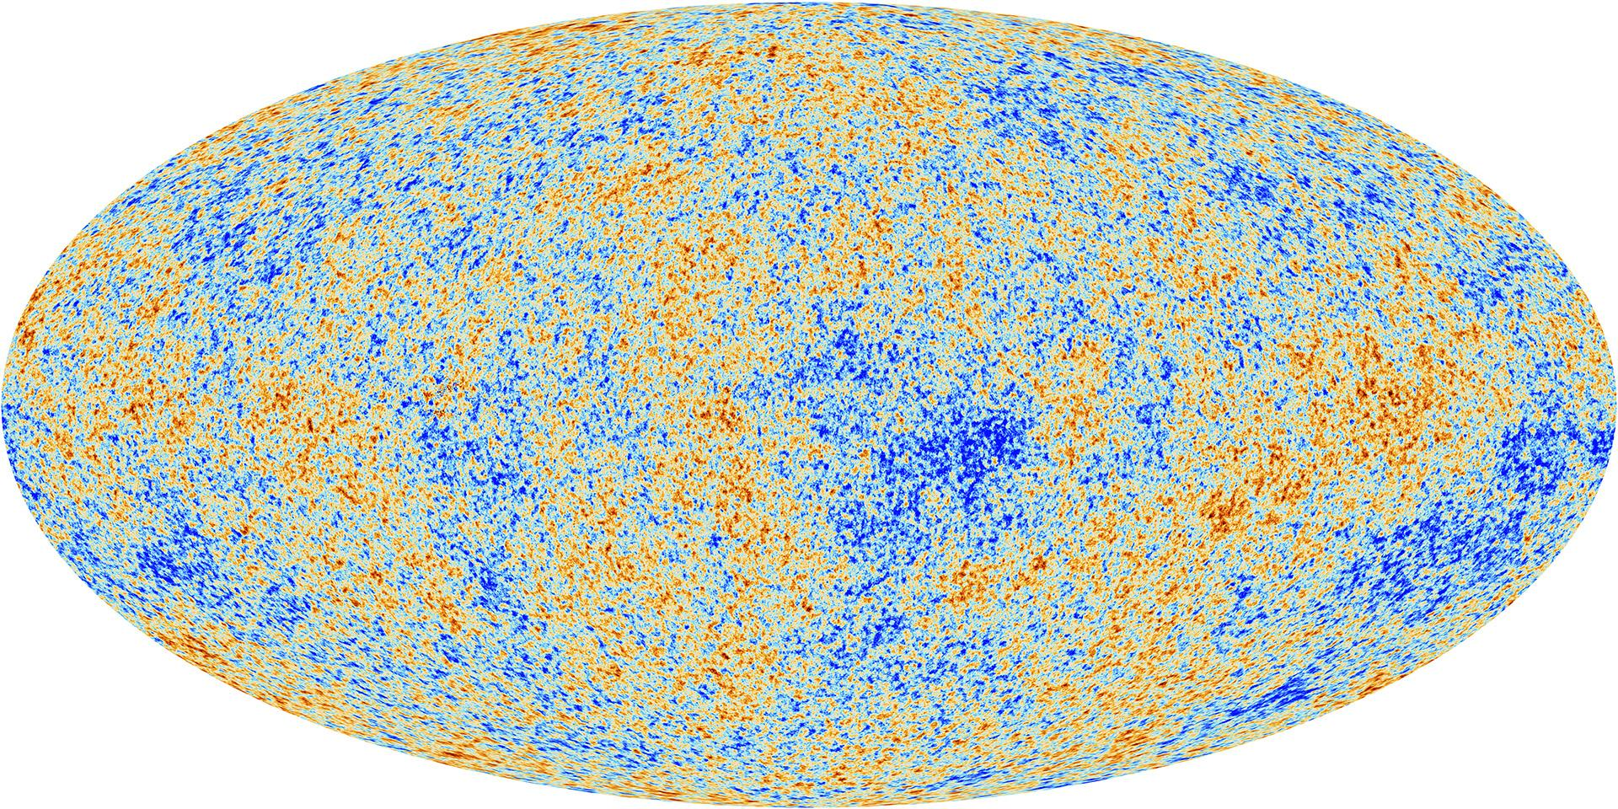
Project 3 Presentation: CMB, LSS, and Cosmological Models
Ryan White
PHYS4080 2023
Source: ESA and Planck Collaboration

Slide 2
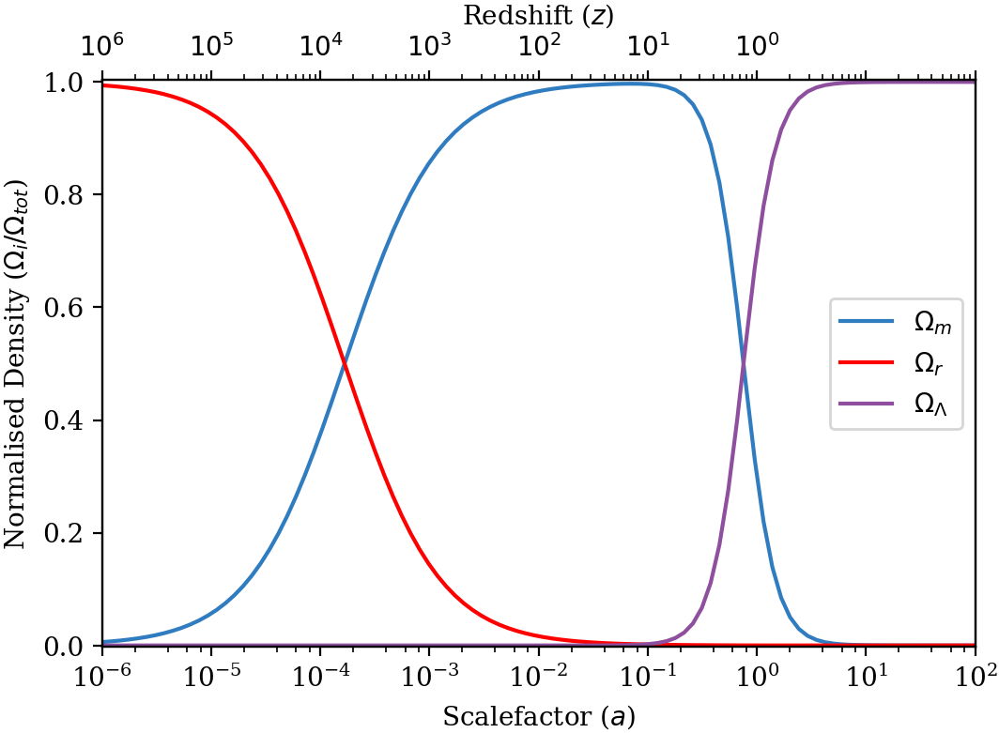
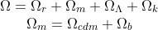
The Cosmological Parameters
Different energy components (cosmological parameters) dominate distinct epochs in the Universe
The dynamics (Hubble flow) of the Universe are determined by these parameters
Several observational probes for dynamics and energy densities at different epochs

Slide 3
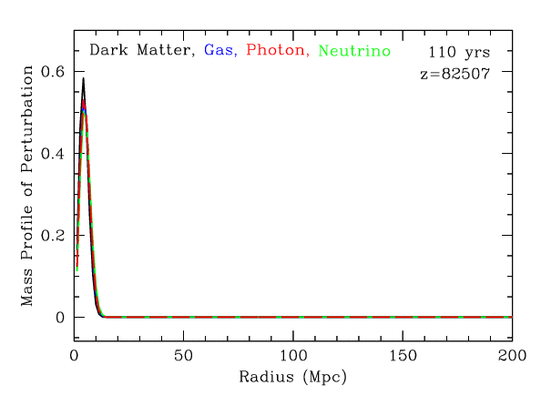
The Baryon Acoustic Oscillations
One of the most complete observational probes of the cosmological parameters
Describes the state of the universe at z~1100
At this time, photons decoupled from baryons
More baryons, bigger peak at sound horizon
More CDM, bigger peak at low radius
Source: Daniel Eisenstein

Slide 4
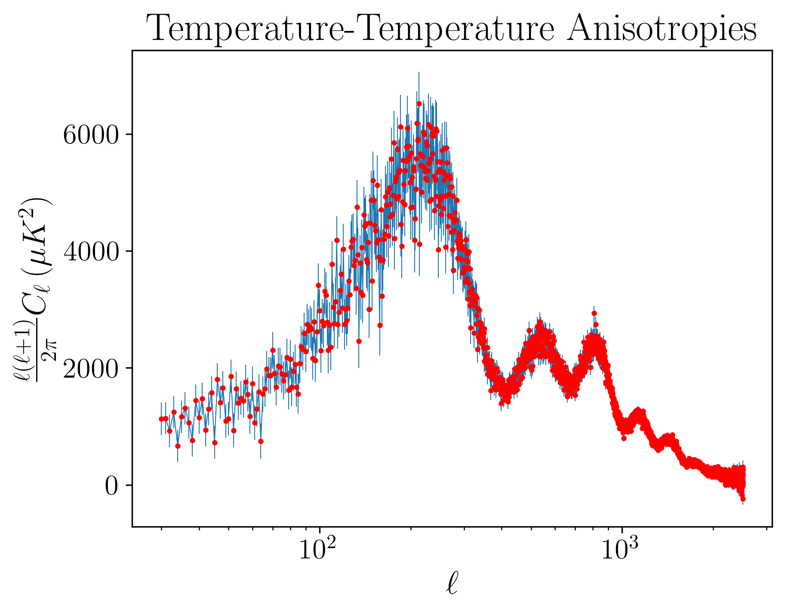
CMB Temperature Power Spectrum
CMB is a snapshot of BAO in time.
Odd peaks are influenced by baryon plasma compression
Even peaks rarefaction
First peak is from the sound horizon
Comparing second and third peaks gives information about cold dark matter
A larger third peak means that CDM had more contribution before recombination
More baryons means damping at smaller scales

Slide 5
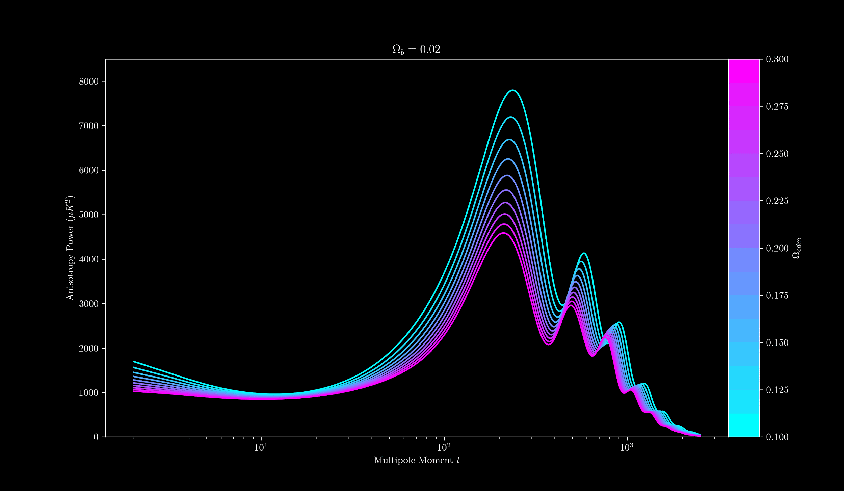

Slide 6
CMB Polarisation
Photons scattering off of baryons creates a net polarisation, especially on small scales
Since particles need to interact, polarisation occurs on scales where diffusion in the baryon plasma is possible
The polarisation peaks are therefore shifted to smaller angular scales relative to the TT power spectrum
Higher baryon density means damping at smaller scales, shifting the polarisation

Slide 7
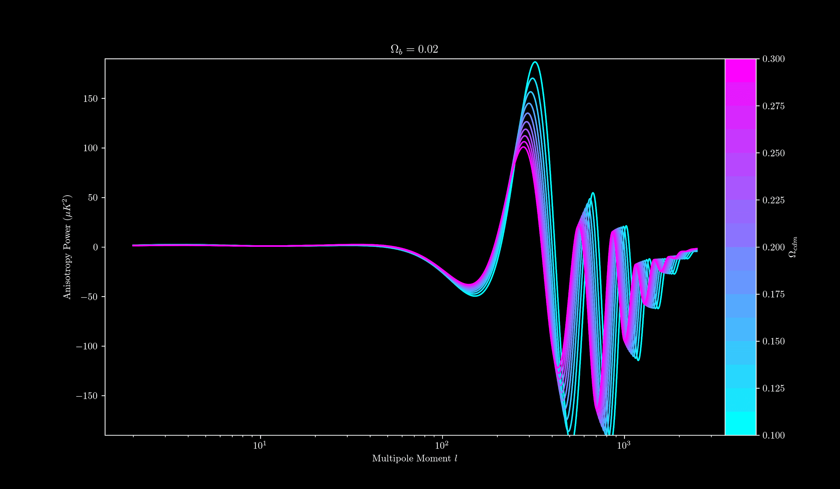

Slide 8
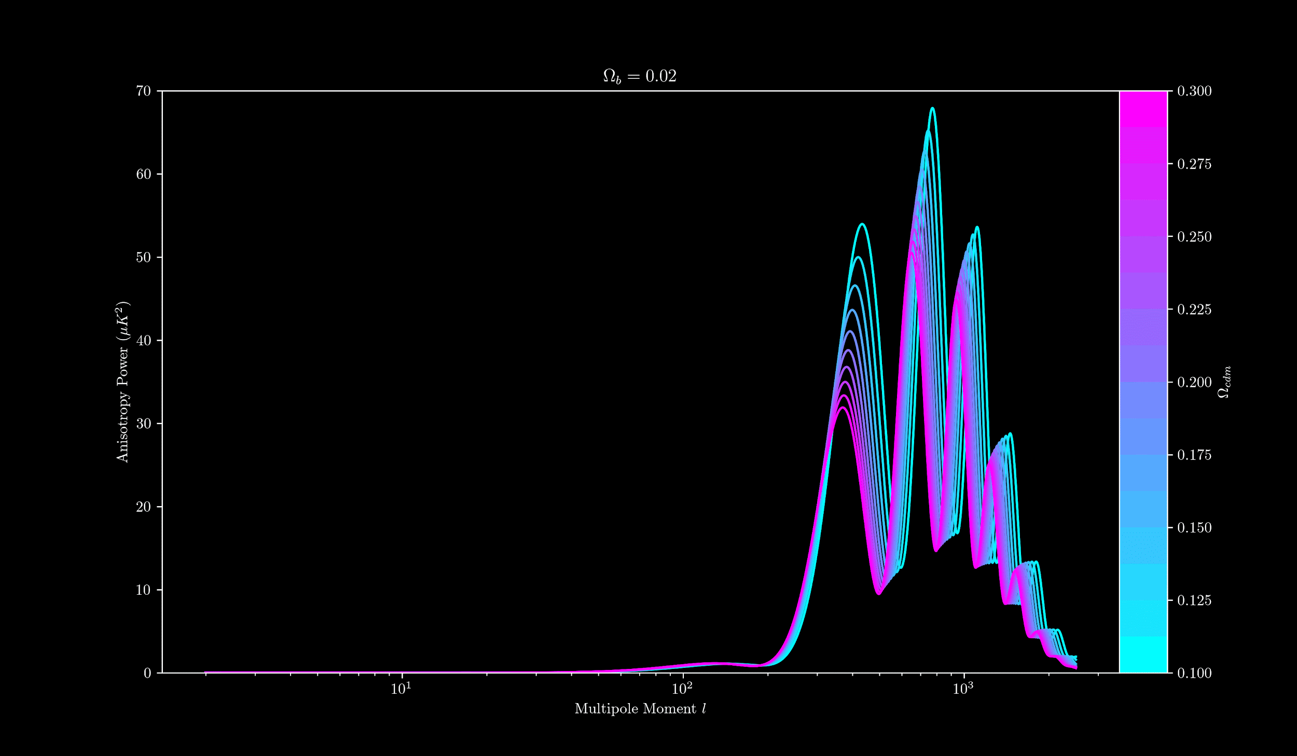

Slide 9
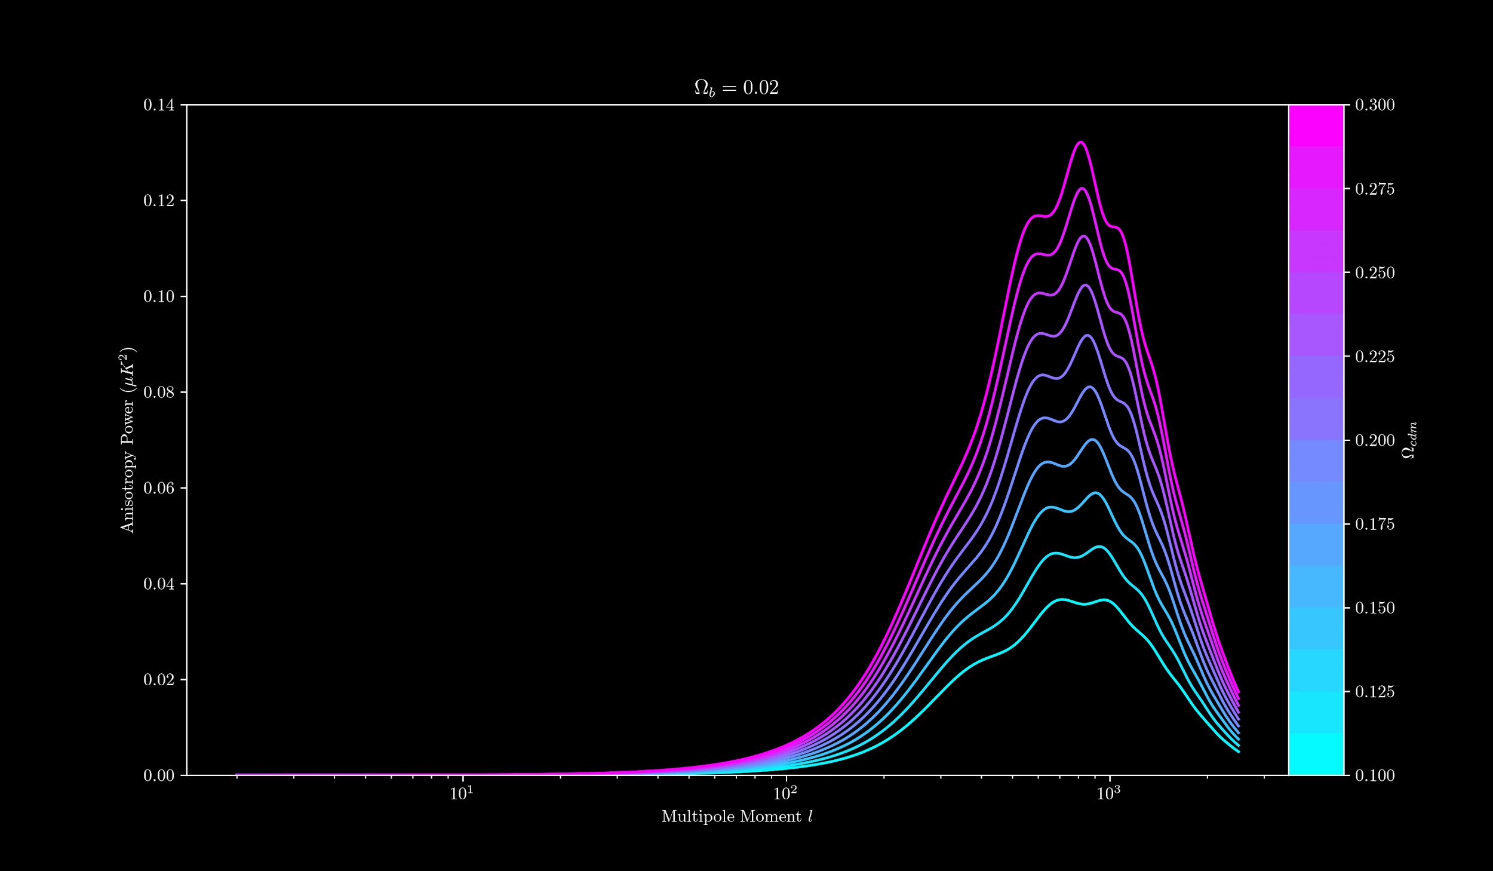

Slide 10
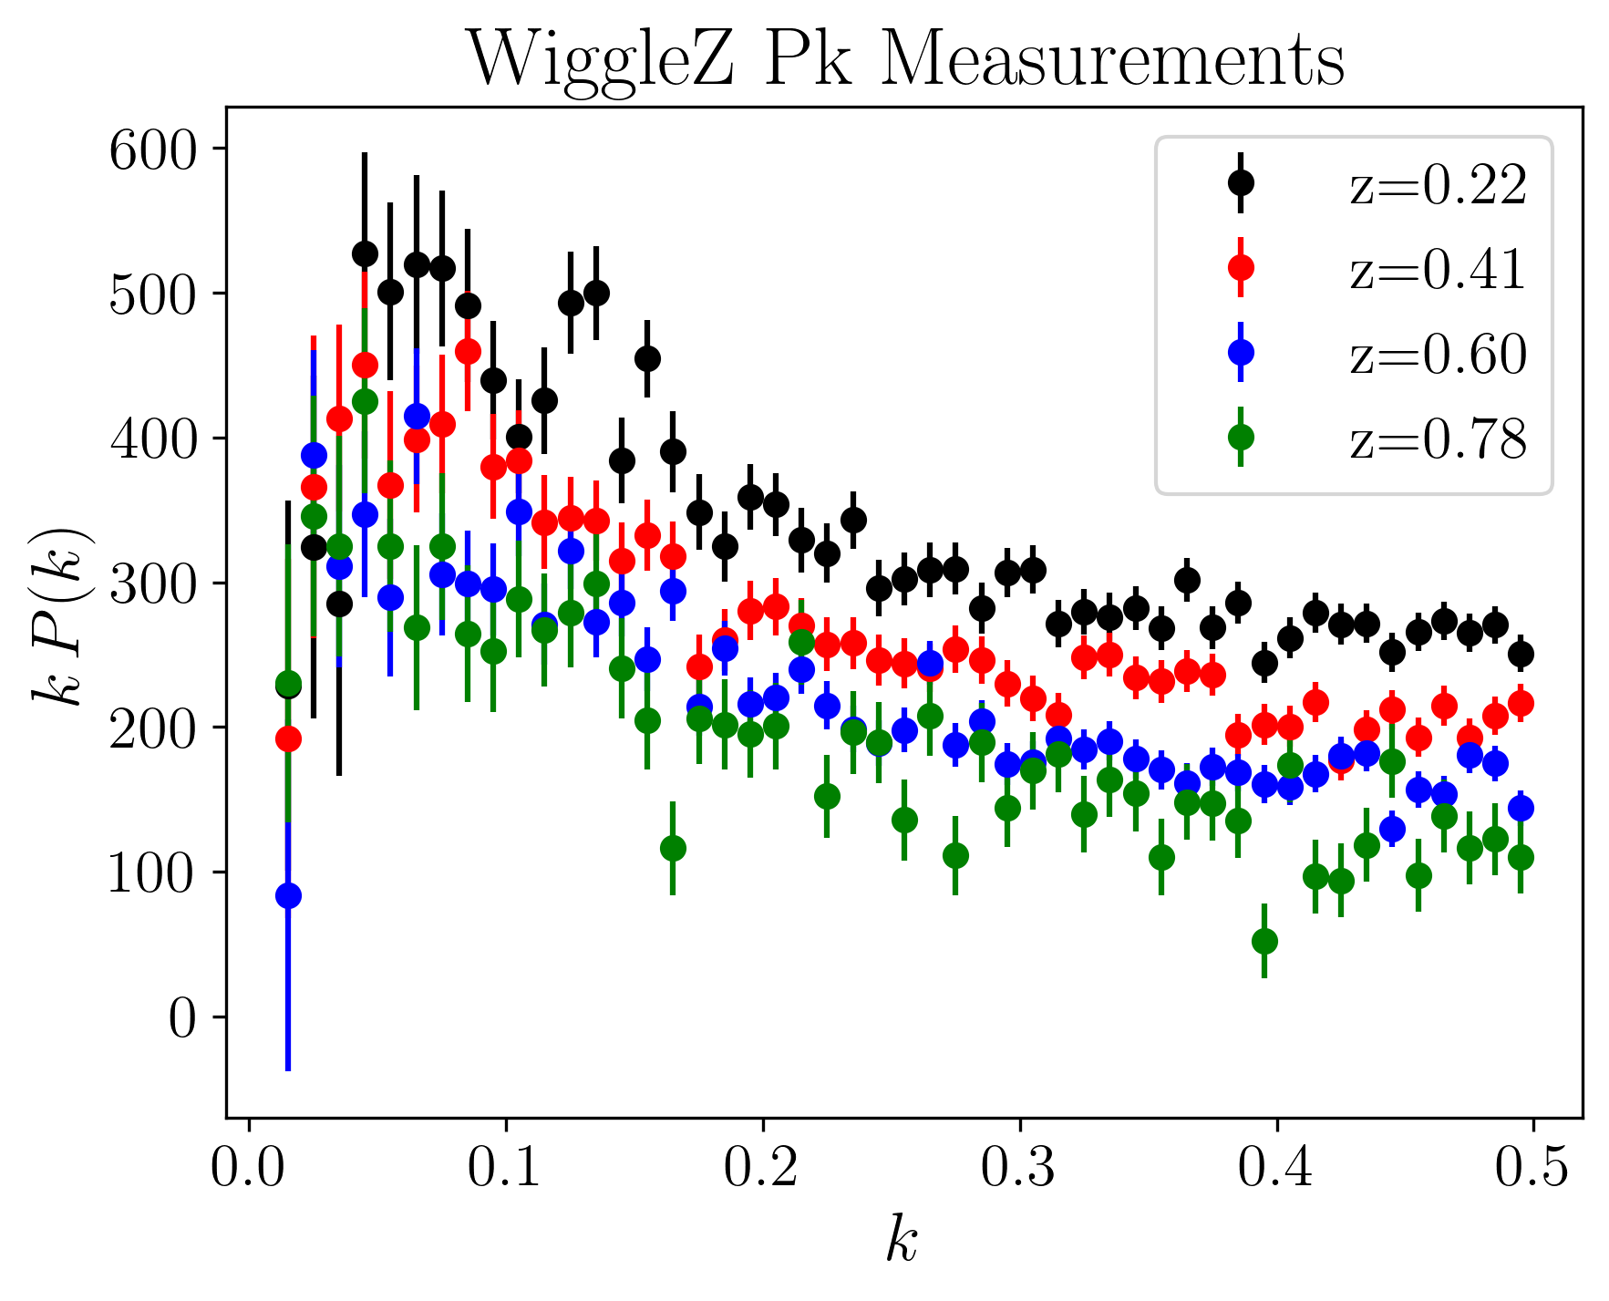
Matter Power Spectrum
Galaxy number densities and separations in the recent Universe indicate dynamical history
Spatial imprint left by BAO in the early Universe
Clustering in the time since last scattering changes the shape of the spectrum
The spectrum is redshift dependent!

Slide 11
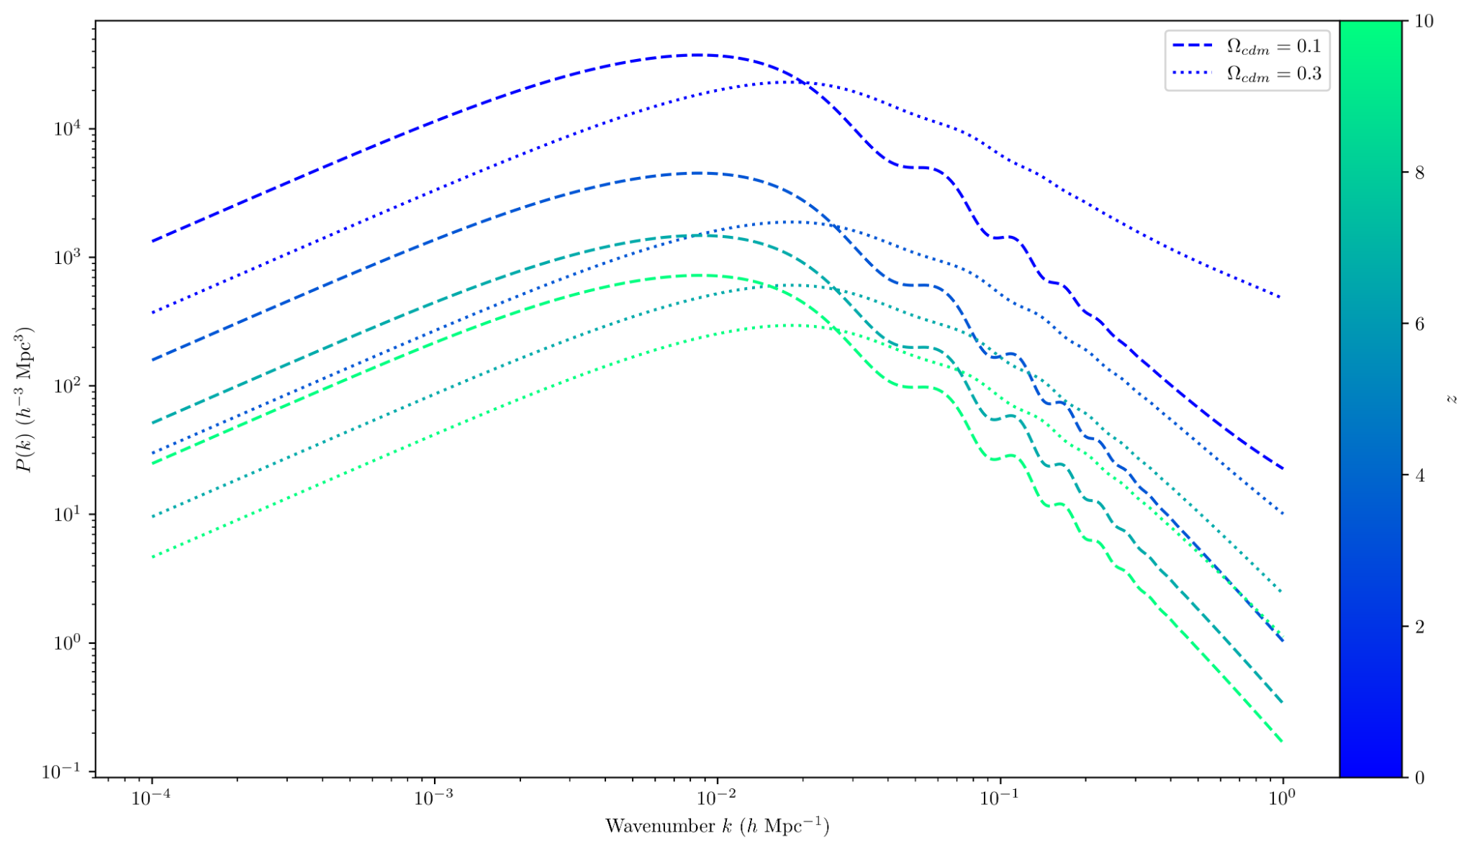
The Matter Power Spectrum
The spectrum is dependent on time
More time to cluster means more power at small scales
The spectrum is dependent on mass
More mass means clustering and collapse faster
CDM smoothes the spectrum from gravitational interaction

Slide 12
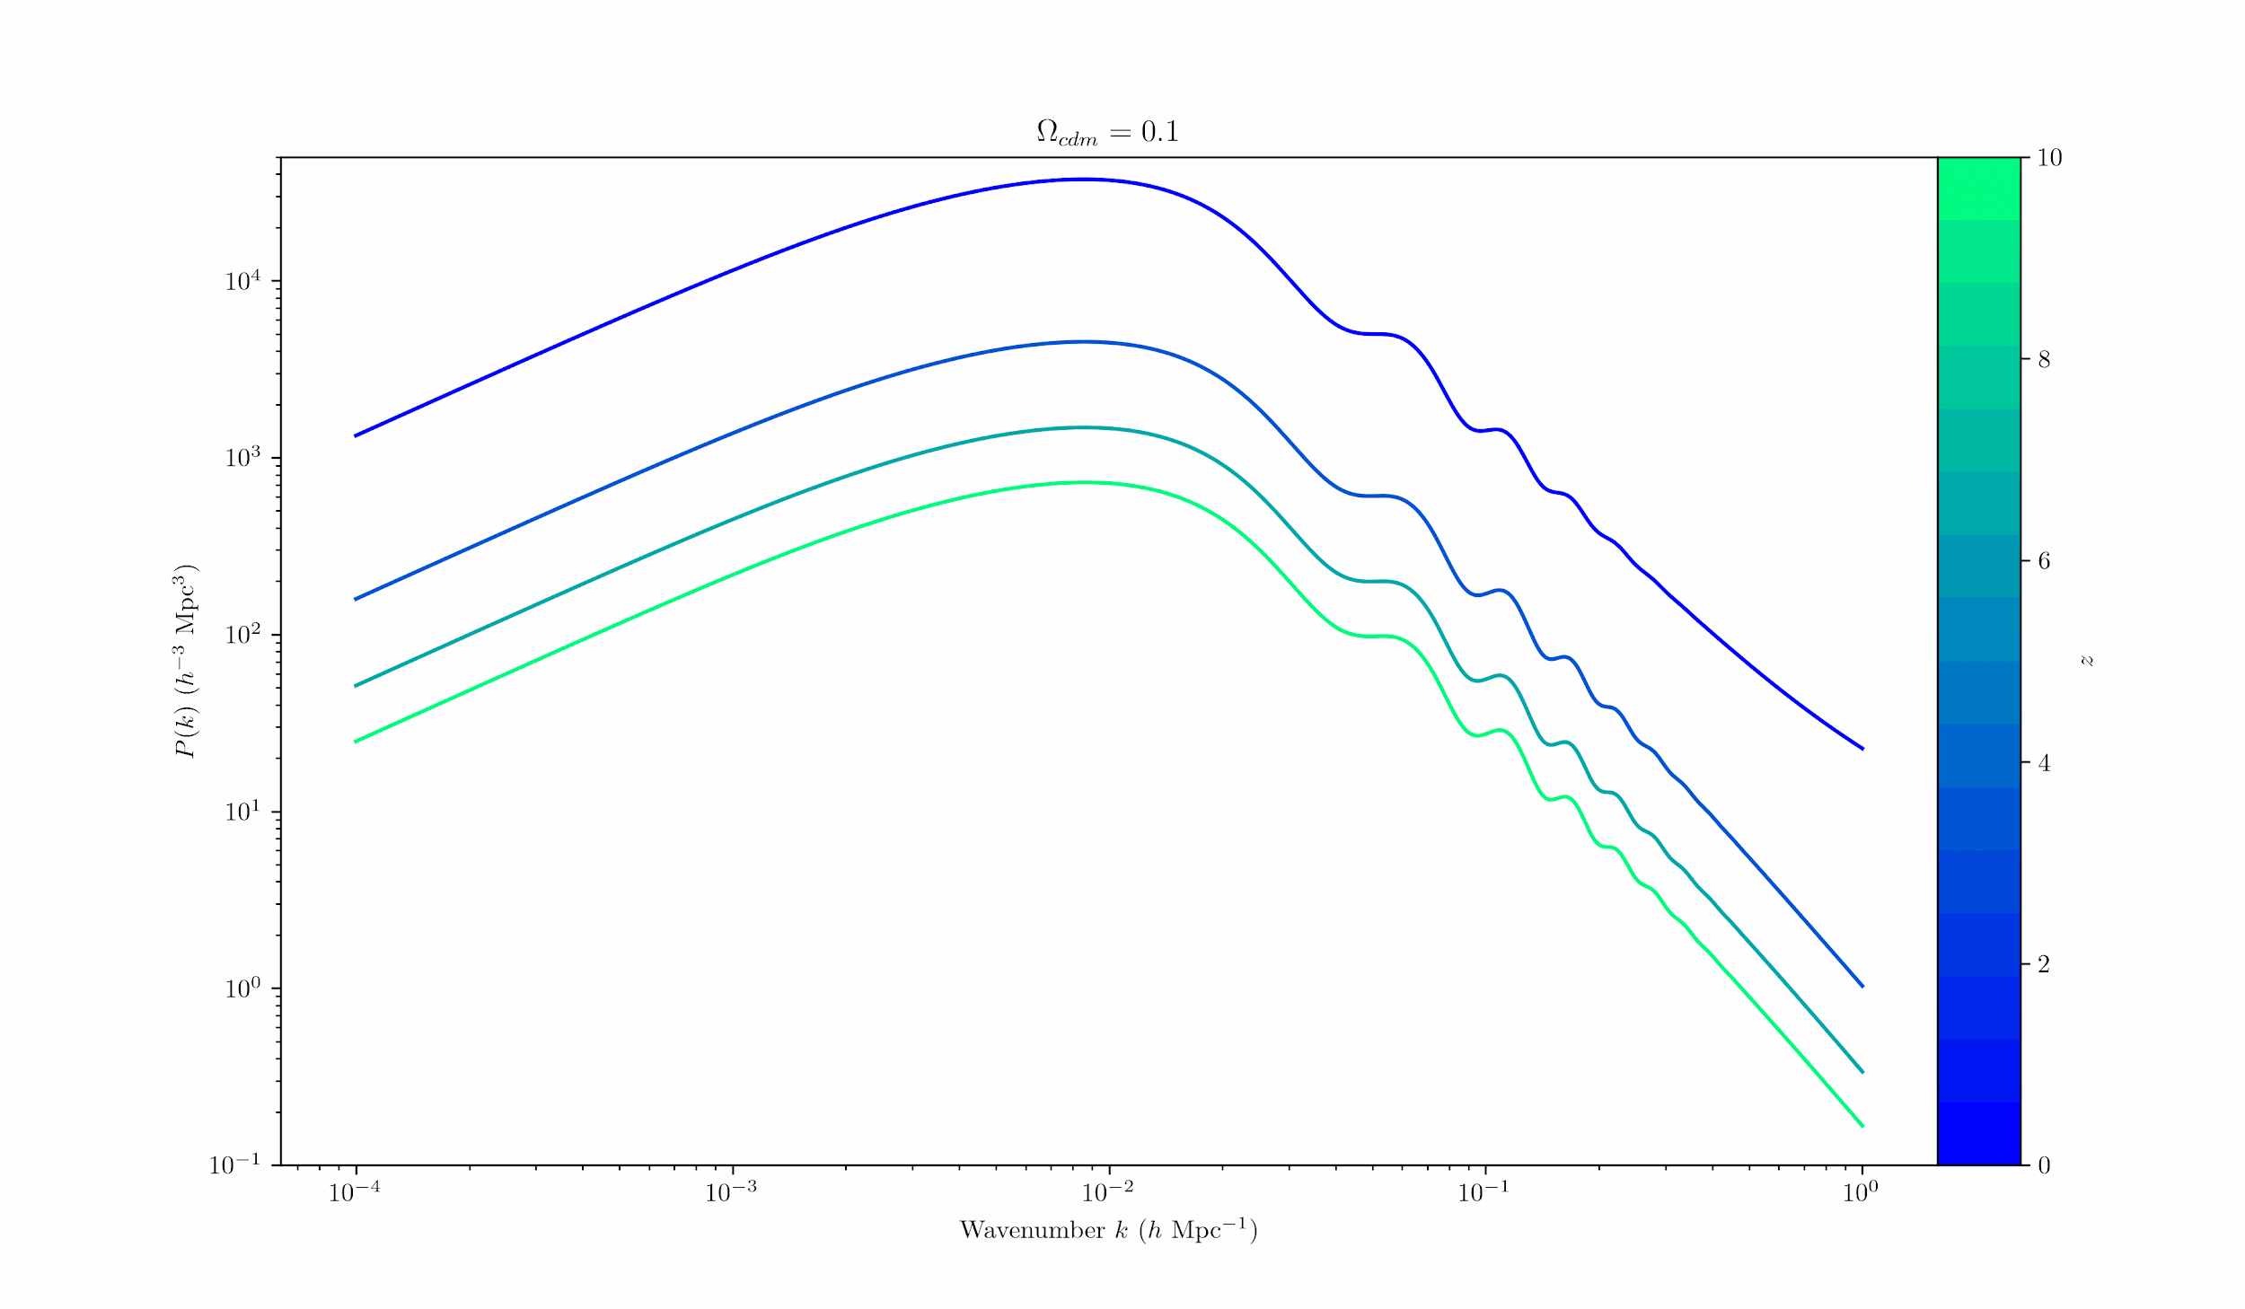

Slide 13
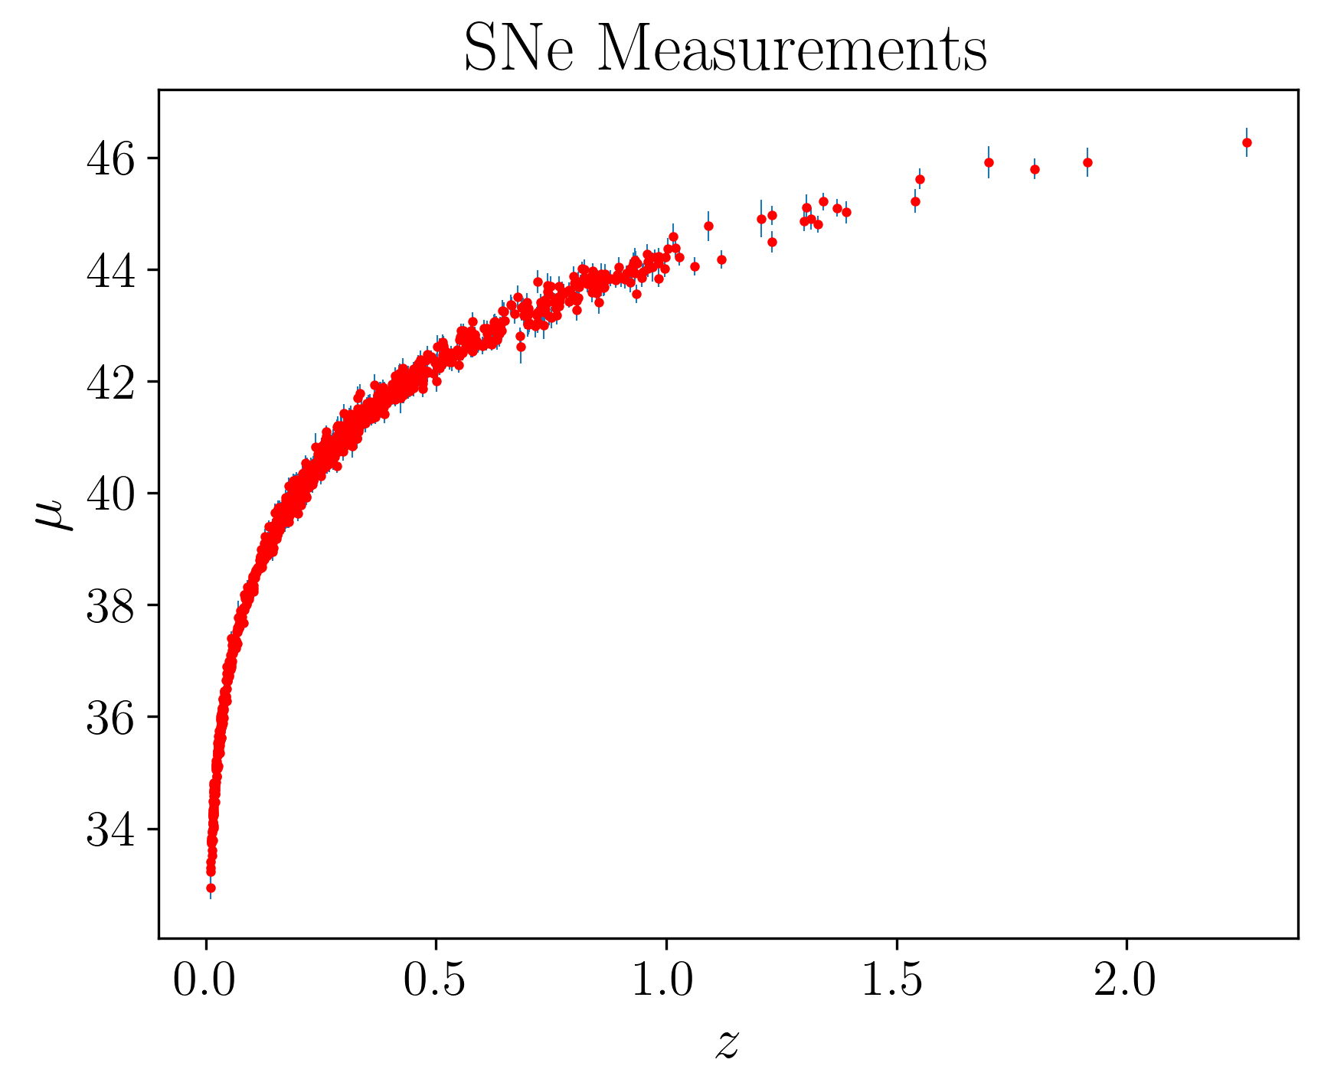
Type Ia Supernova
Help to determine cosmological parameters at high redshift
High redshift SNe Ia further away than originally expected
Won a Nobel Prize!
Constrains matter and dark energy densities which influence the Hubble flow
Higher CDM/baryon density means lower distance modulus

Slide 14
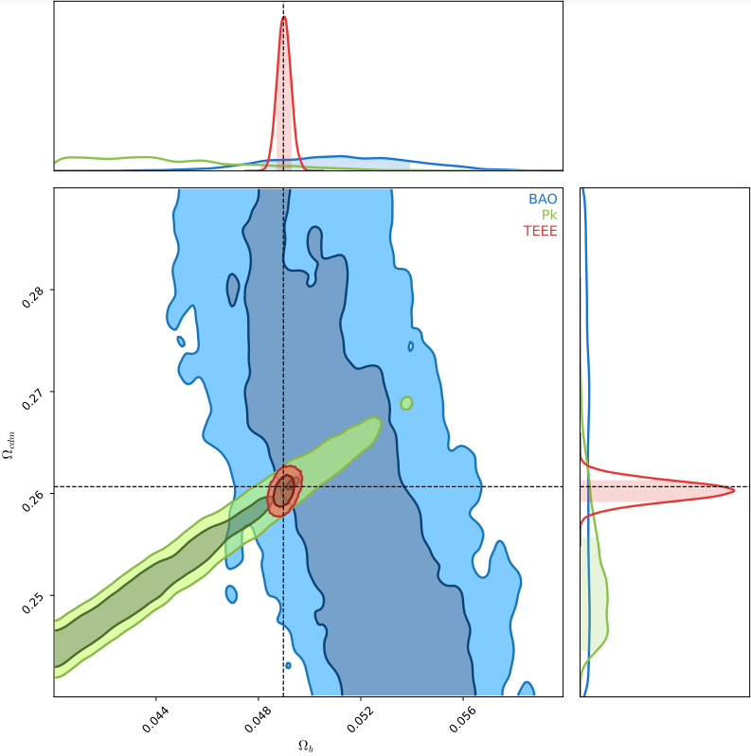
Parameter Fitting
Different observables constrain parameters in different ways/amounts
We can estimate the values of parameters with Bayesian inference (MCMC)
Fitting parameters alone barely constrains parameters of interest
Need to fit the data simultaneously to get good constraints
Degeneracies in CDM+baryon combinations, broken by CMB

Slide 15
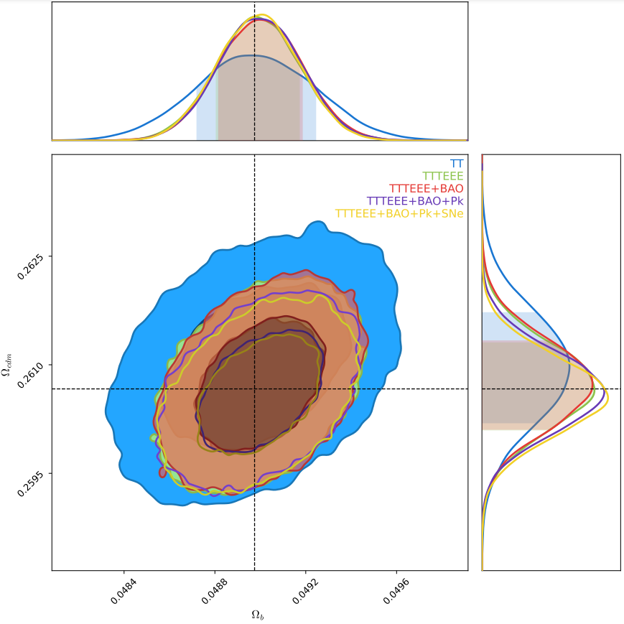
Parameter Fitting
Fitting all observables simultaneously gives precise parameters
More datasets/observables generally leads to a finer likelihood contour
Using all data, we obtain

Slide 16
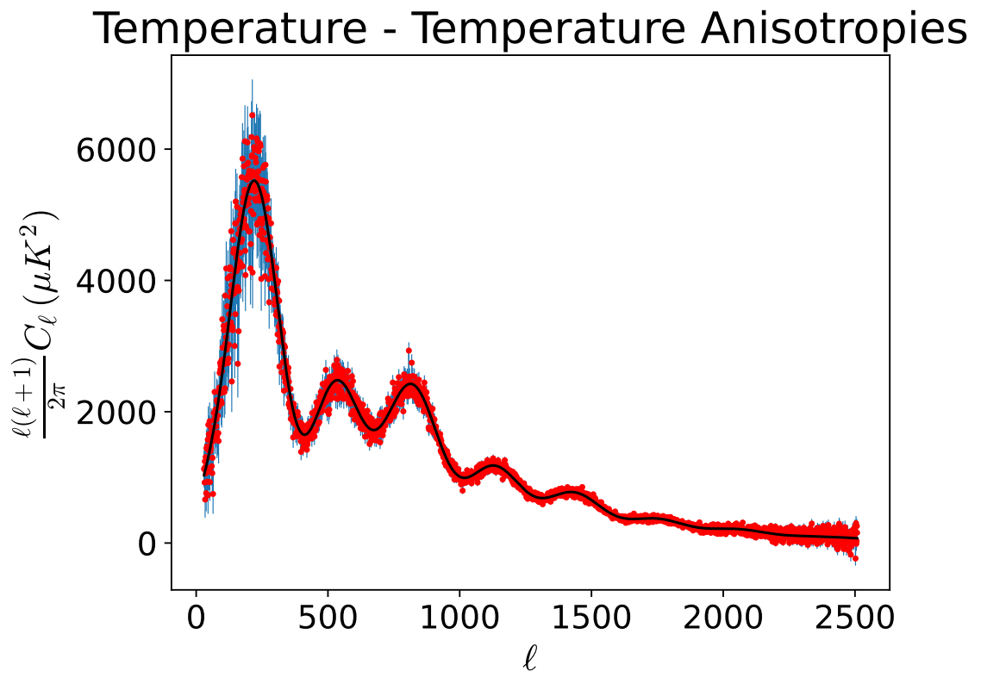
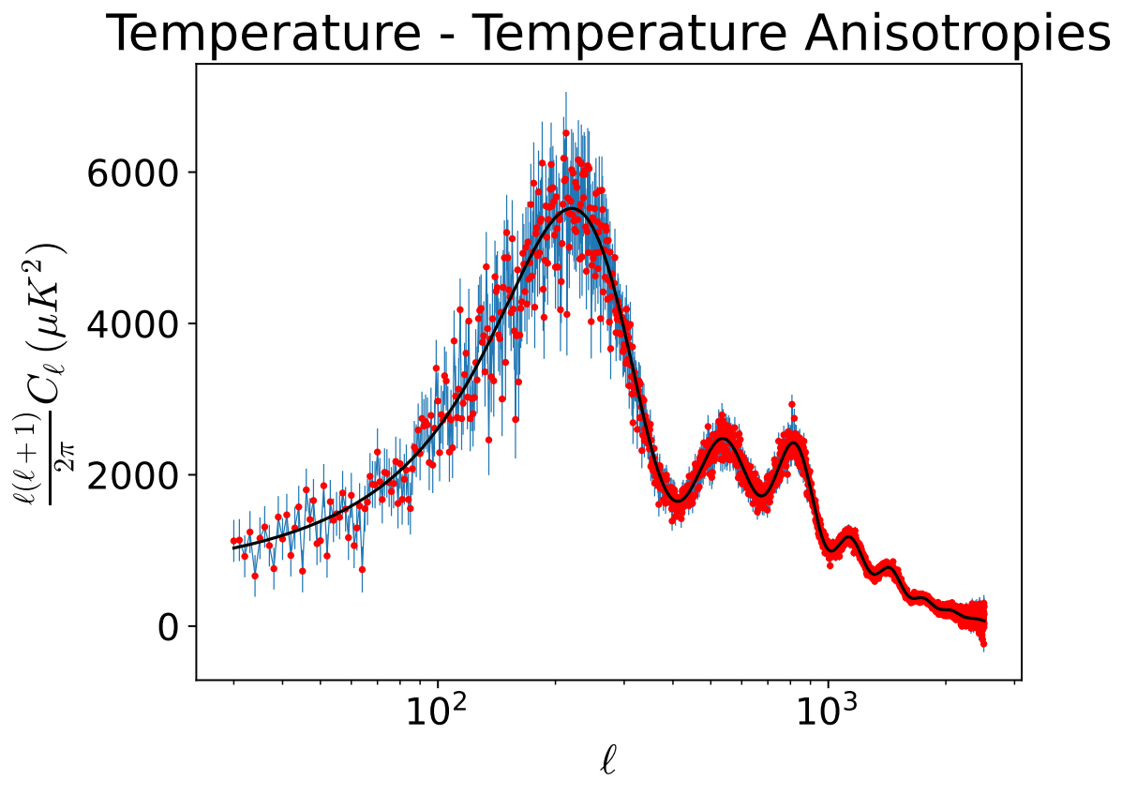

Slide 17
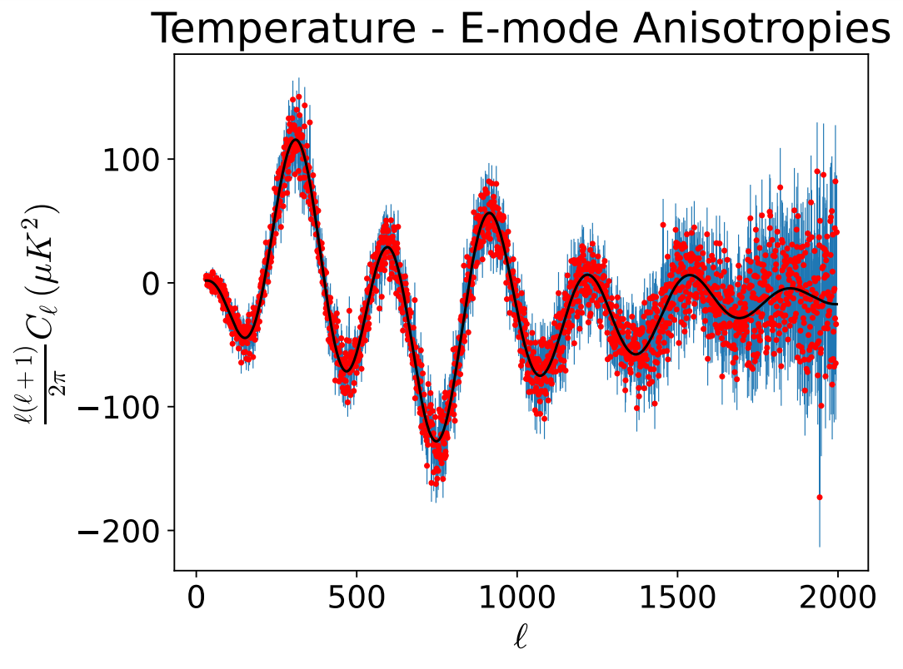

Slide 18
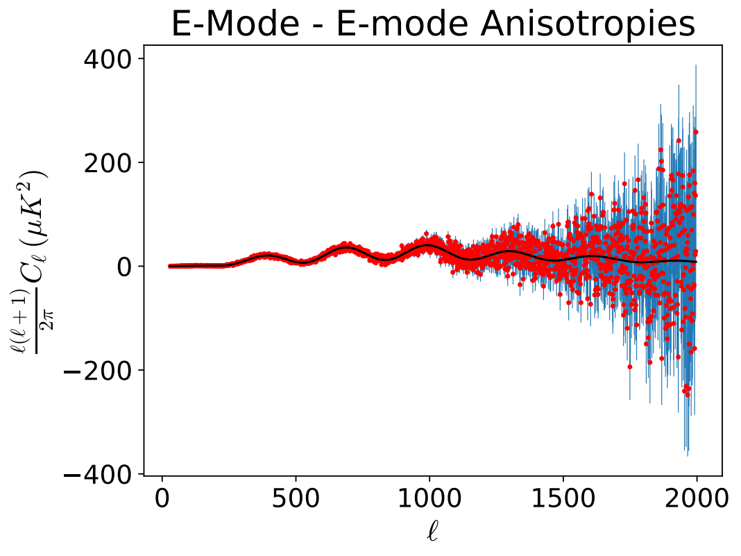

Slide 19
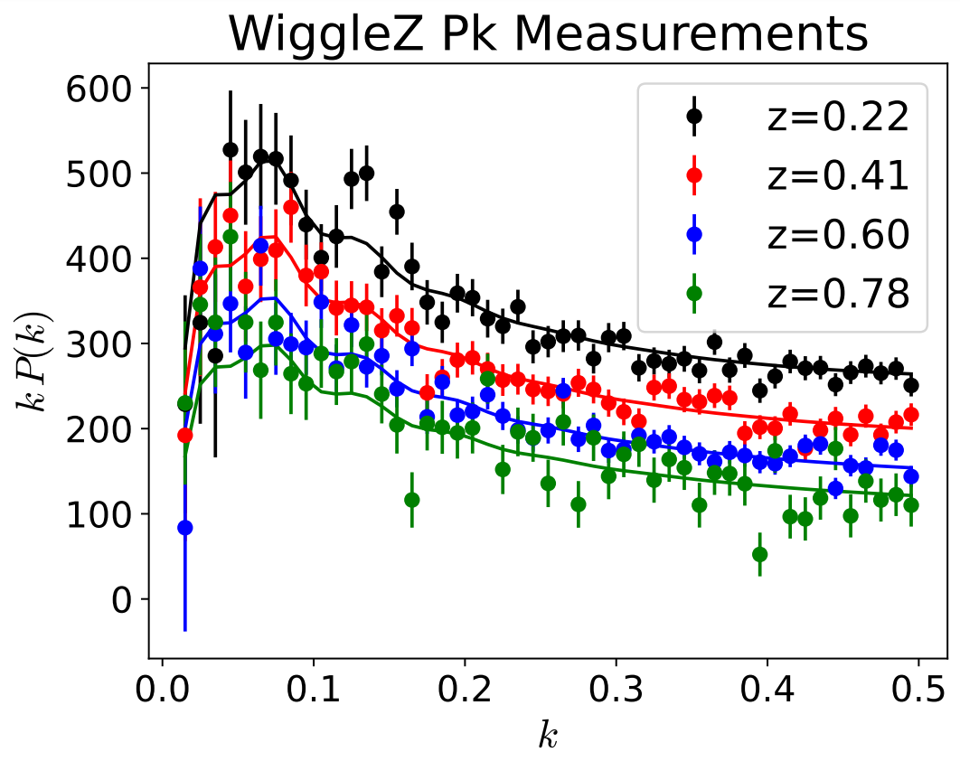

Slide 20
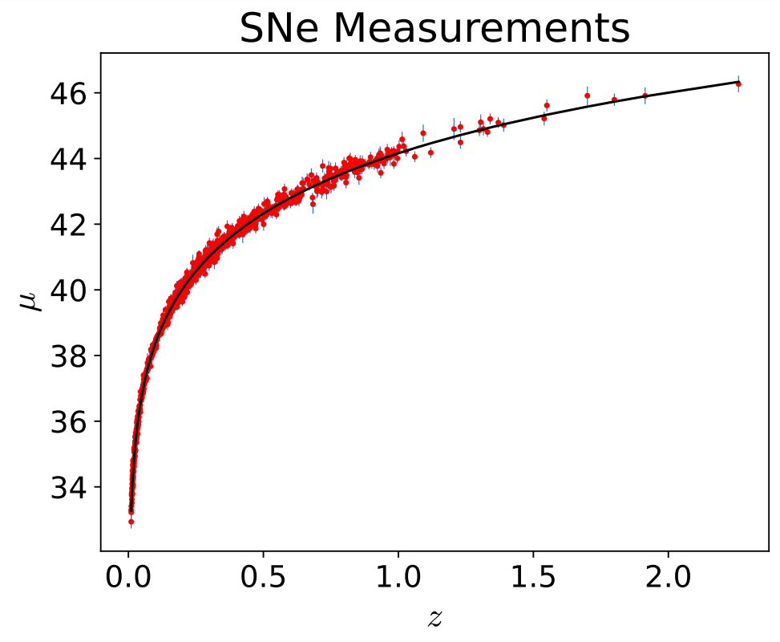

Slide 21
References
Eisenstein, D, 2020. What is the acoustic peak? https://lweb.cfa.harvard.edu/~deisenst/acousticpeak/acoustic_physics.html https://scholar.harvard.edu/deisenstein/book/export/html/28634
ESA and Planck Collab. 2013. Planck reveals an almost perfect Universe https://www.esa.int/Science_Exploration/Space_Science/Planck/Planck_reveals_an_almost_perfect_Universe
A. Lewis, A. Challinor, and A. Lasenby, Astrophys. J. 538, 473 (2000) https://arxiv.org/abs/astro-ph/9911177

